Slide 1
To the: Waterway Commission
Call for an Ordinance in Jacksonville City and Support to Ban Fracking in Florida State
John Debus

Slide 2
What is Fracking?
Hydraulic Fracturing, or “Fracking," refers to the
process of extracting natural gas and/or oil from tight rock formations below the surface using millions of gallons of water, gases, chemicals, and proppants (usually fine sand) at high pressure to break apart and release hydrocarbons present in the rock. Activities ancillary to this process include other well stimulation methods such as acidization.

Slide 3
The Hydraulic Fracturing Water Cycle

Slide 4
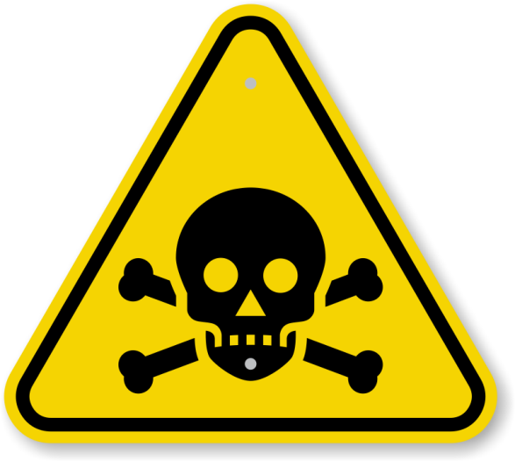
The Chemicals Used in Fracking
Out of 2,500 hydraulic fracturing products, more than 650 contain chemicals that
are known carcinogens.
Most are not biodegradable.
Once they are in the aquifer
or ground waters, they remain there forever.
The Energy Policy Act of 2005 (aka the Fracking Loophole) removed EPA’s authority to monitor fracking.

Slide 5
A Closer Look at the Downside
Water shortages
Holding tank leakages
Well casing failures
Drinking water and irrigation water contamination
Methane gas release
Loss of property values
Notes:
t

Slide 6
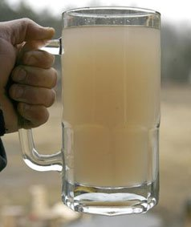
Water Shortages
Each natural gas well requires between 1 and 8 million gallons of water for fracking.
10 to 30% of this water is returned to the surface and must be disposed.
Most produced water stays
below ground where it can
lead to irreversible
contamination of underground
aquifers.
Photo: “Drinking Water” in Dimock, PA

Slide 7
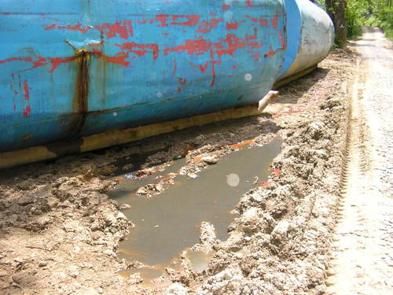
Holding Tank Leakages
The EPA estimated up to 3700 spills above ground per year, with some rivers and drinking water sources seriously contaminated.

Slide 8
Well Casing Failures
Well-casing failure has been studied by the industry. ln 2010, Pennsylvania drilled 1,454 wells, of which 90 failed (6.2%). ln 2011, 1,937 wells were drilled and 121 failed (6.2%). This data is for new wells, and well casings are more likely to fail with age. ln 2010, Pennsylvania's DEP cited 451 wells with 1,544 violations that harmed water quality. The only safe frack drilling is no drilling at all.

Slide 9
Drinking/Irrigation Well Contamination
Last fall in California it was discovered that about 3 billion gallons of fracking wastewater was injected into Central California drinking water and farmland irrigation aquifers. They found extremely high levels of the extremely dangerous chemicals: arsenic and thallium. There are no good disposal options for wastewater anywhere, but especially in Florida where our limestone base and the associated geologic features could allow for the upward migration of hydrocarbons and frac fluids. Polluting our waters and endangering our pristine preserves does not make sense in a state where we rely on tourism, agriculture, and real estate to sustain our economy.

Slide 10
Methane Gas Release

Slide 11
Loss of Property Values
Within a half mile of shale gas wells, properties with private drinking water wells dropped 22% in value (Duke University Study).
Banks are increasingly unwilling to offer mortgages on properties with oil and gas leases.
Most or all homeowners insurance policies exclude damage from such things as environmental contamination.
(Insurance Information Institute)

Slide 12
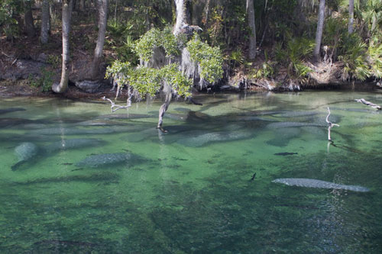
What’s at Risk In Florida
Drinking Water
Natural Springs
Offshore Reefs
Freshwater and
Saltwater Fishing,
including Commercial Shellfish Industry
Tourism
Agriculture and Aquaculture

Slide 13
Resolution
Requesting a Statewide Ban on Extreme Hydraulic Fracturing, Acid Fracturing and any form of Extreme Well Stimulation in Florida
In unison with the other 35 counties and 50 cities that have already passed a proclamation, Resolution, or Ordinance in support of a State Ban.

Slide 14
Conclusion
I ask the City Commission to insist that no harm be done to our environment and economy and thus consider and approve a
Ordinance to Ban Fracking in Jacksonville such as many cities and counties in Florida have done or are in the process of doing.

Slide 15
Cost to the people/tax payers

